Slide 1

Multi-omics Boot Camp
Analysis of Omics Data for Research Studies
Advanced Polygenic analysis and Summary statistics
Nick Mancuso
nmancuso@usc.edu
Tsz Fung Chan
tszfungc@usc.edu

Slide 2
Recap
Understand GWAS, PRS, and summary-based integrative analyses
Understand statistical modeling of PRS and GWAS summary data
GWAS analysis
Integrating PRS as a risk factor
Integrating SNP-based predicted omic as a risk factor
Analyses with multiple PRS.
Apply the methods mentioned above in R and be able to interpret the results

Slide 3
Goals
Characterize shared pathways using GWAS summary statistics
Understand truncated Singular Value Decomposition
Apply the methods mentioned above in R and be able to interpret the results

Slide 4
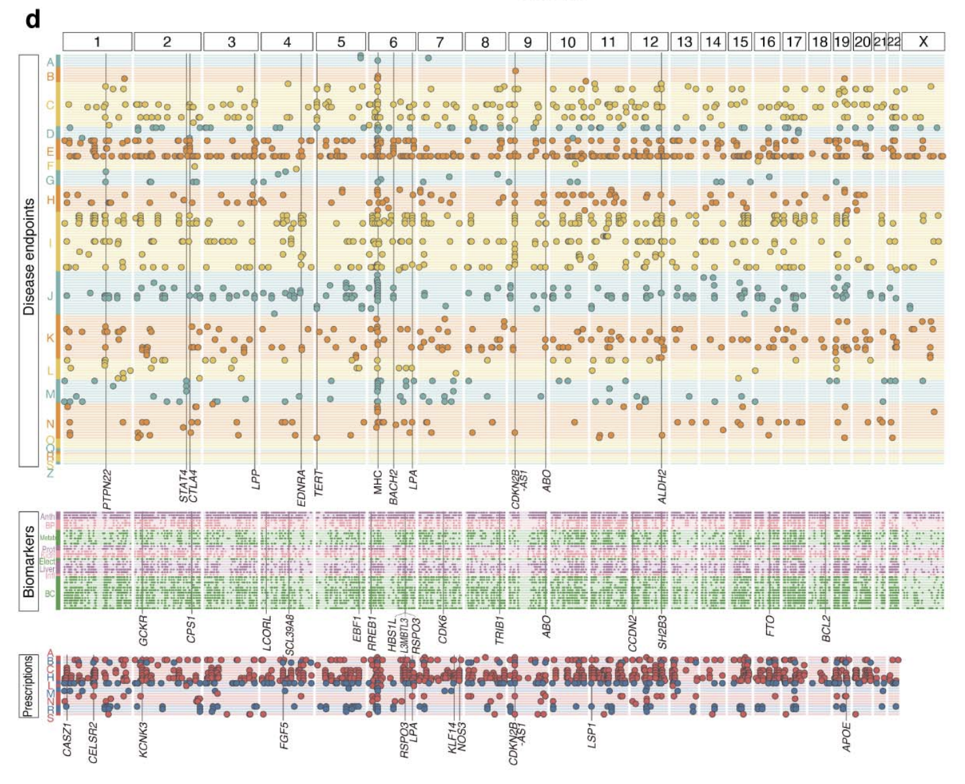
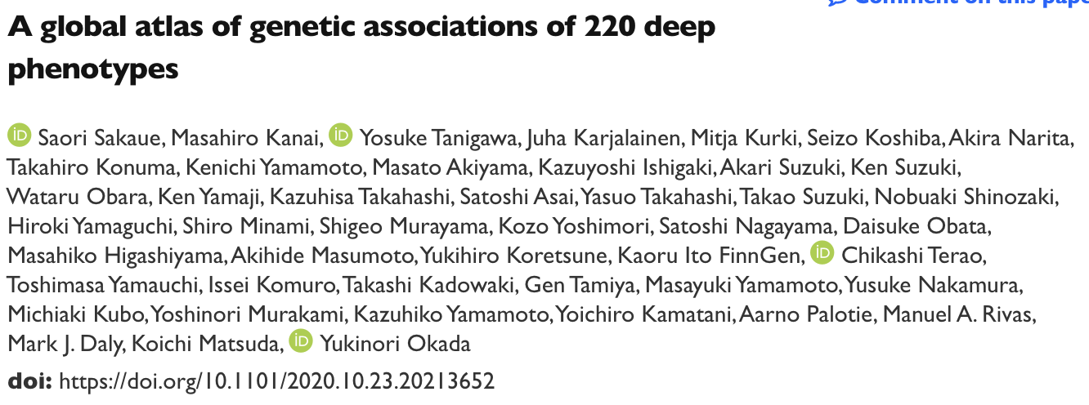
Pleiotropy is pervasive
N=179k; 220 deep phenotypes
Question: how can we characterize shared genetic components?

Slide 5
Thought Experiment Pt I: Think Hard
Goal: characterize shared genetic components across large number of phenotypes
Constraints:
Needs to be fast 🡪 use GWAS summary data
Needs to focus on signal 🡪 keep only SNPs w/ P < 5e-8
Needs to … find … shared … genetic components ?
How?

Slide 6
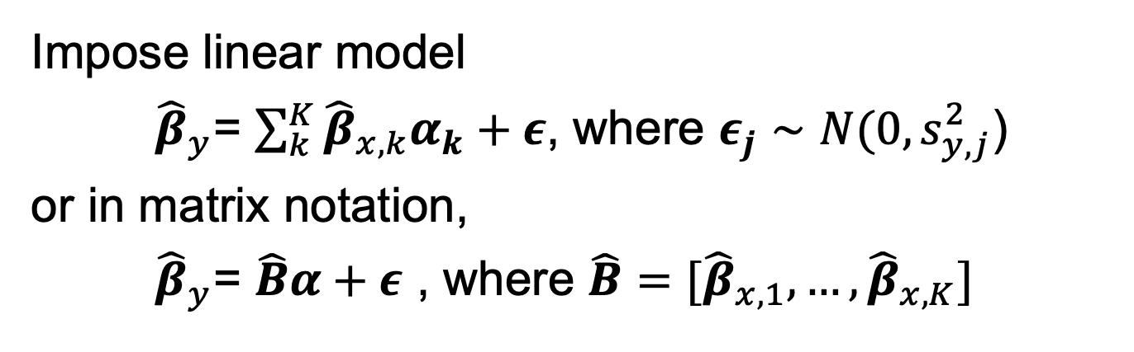

Recap: Multi-variate MR
Burgess, et al. American Journal of Epidemiology 2015;
Jiang, …, Mancuso, …, Conti. American Journal of Epidemiology. 2020.

Slide 7
Thought Experiment Pt II: Think Harder
Goal: characterize shared genetic components across large number of phenotypes
Constraints:
Needs to be fast 🡪 use GWAS summary data
Needs to focus on signal 🡪 keep only SNPs w/ P < 5e-8
Needs to … find … shared … genetic components ?
🆗
🆗
How?
🤯

Slide 8
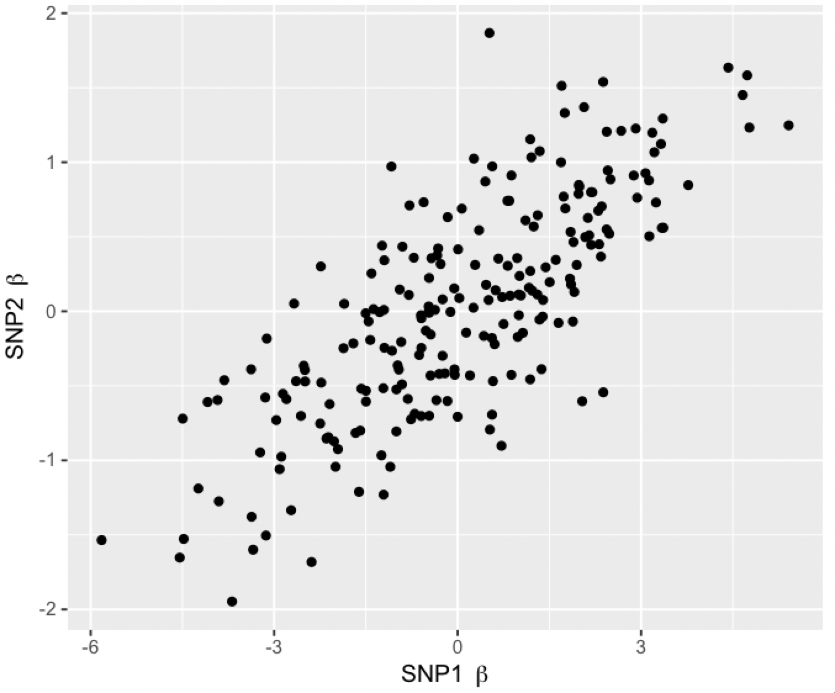
Thought Experiment Pt III: Think Hard with a Vengeance
Alert - Simulated Data - Alert
When in doubt, make a plot!
What can we make of this?
How can we generalize this across many SNPs?
How to keep “interesting directions” underlying phenotypes?

Slide 9
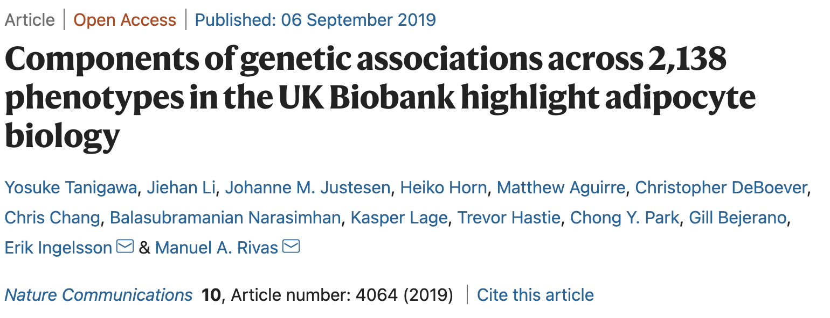
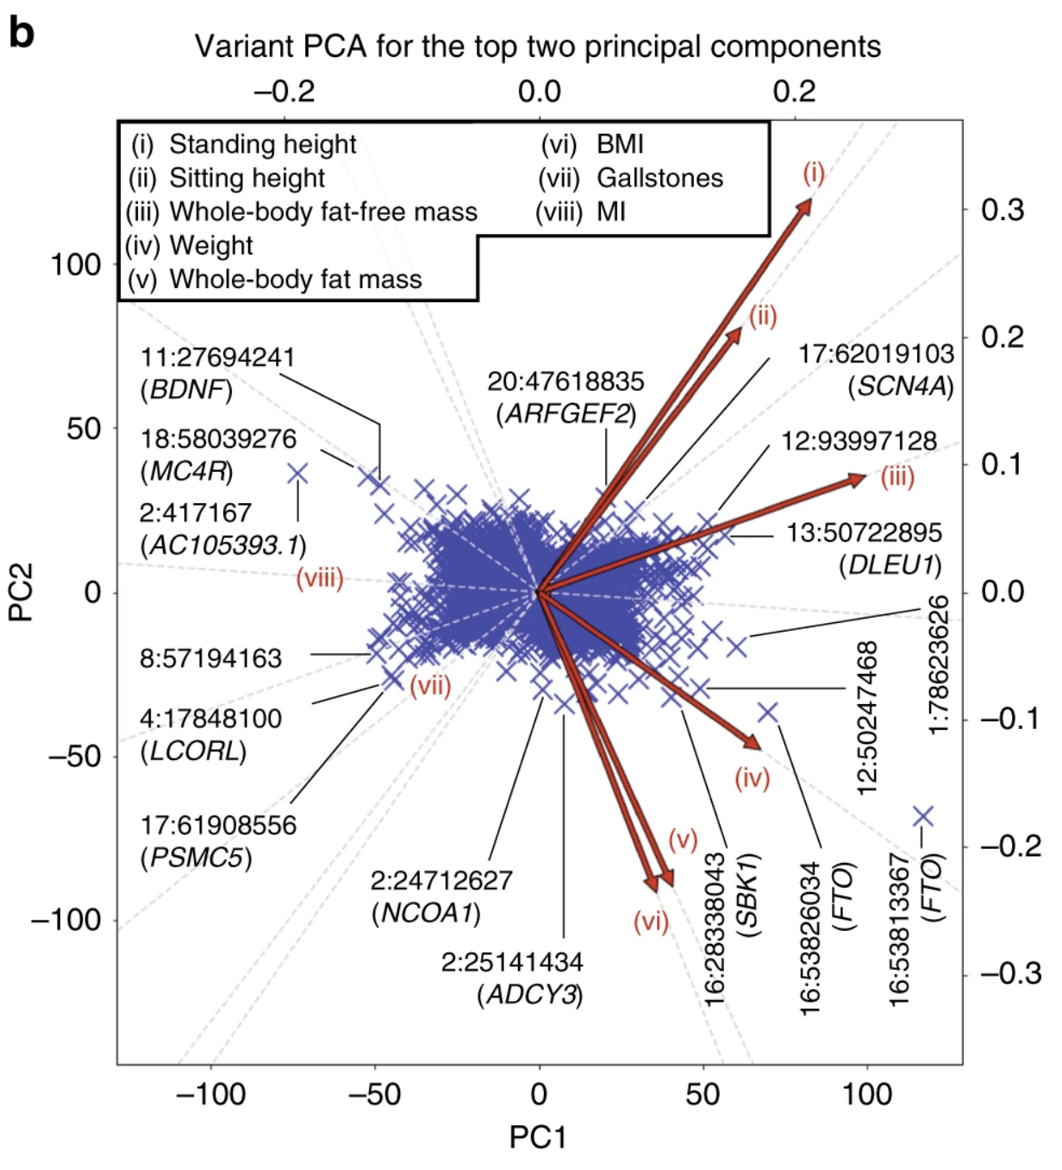
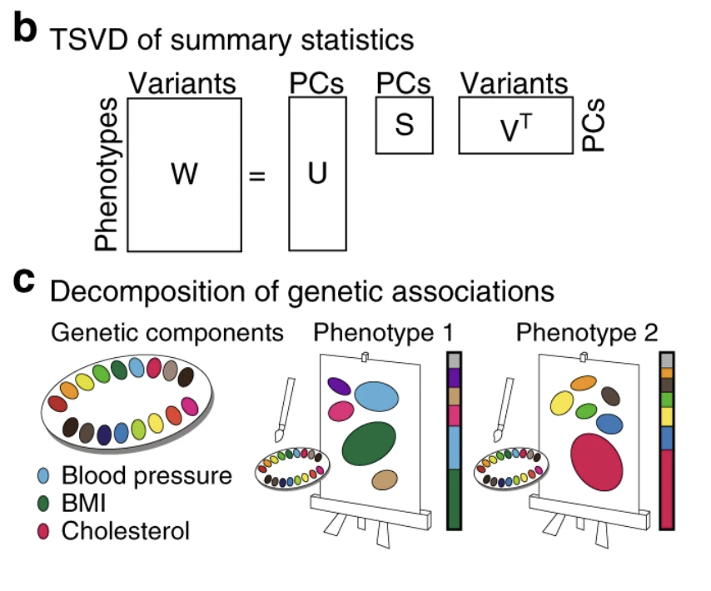
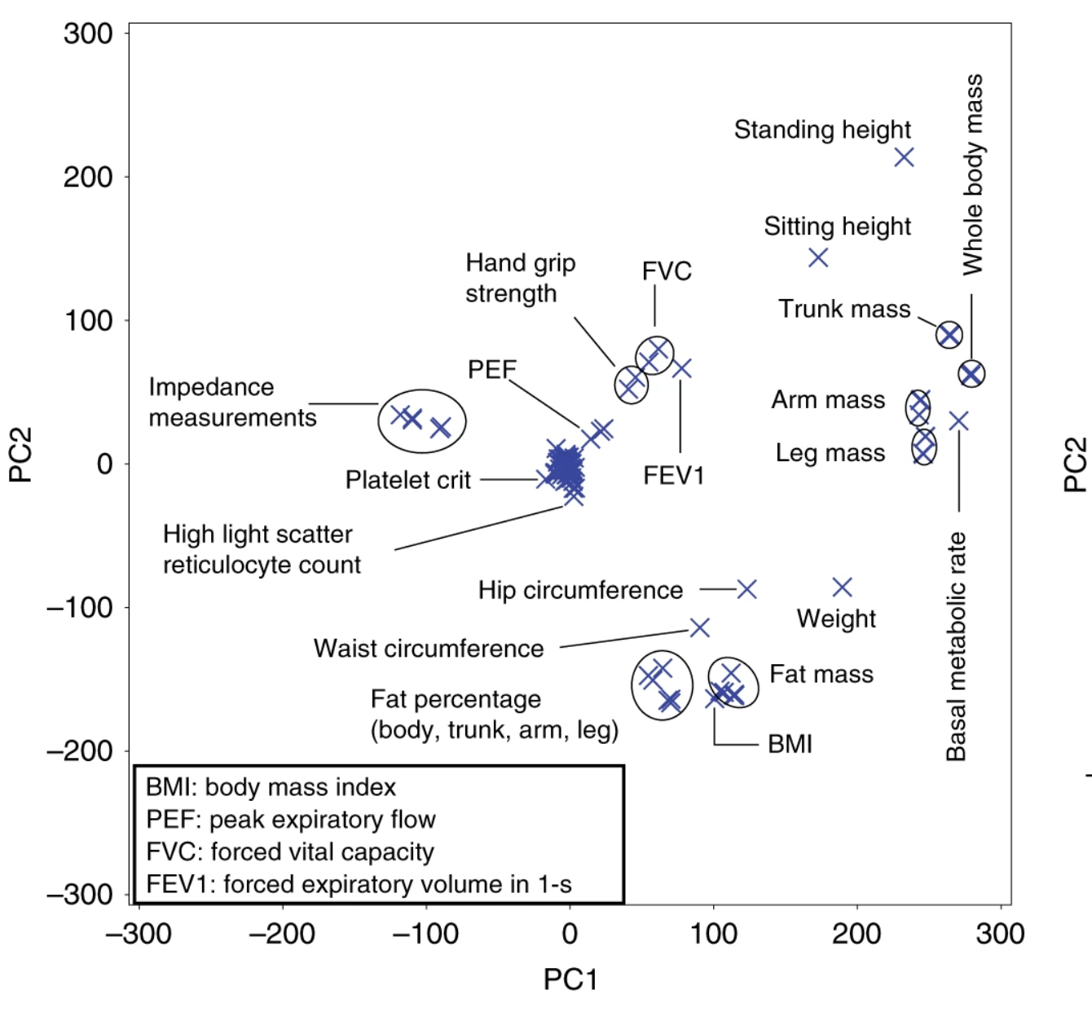
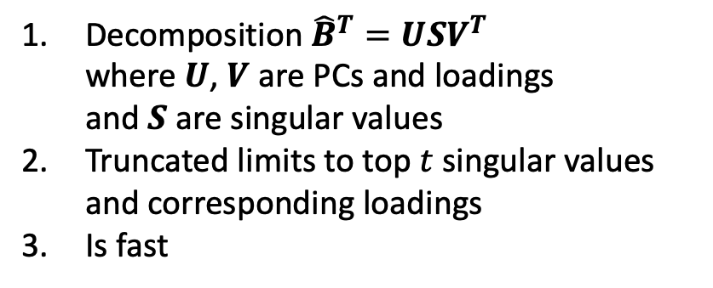
DeGAs: Truncated SVD

Slide 10
Questions?
Thank you! Short break, and then lab!
PS: More Clustering, PCA, and high-dimensional visualization with Dr. Kimberly Siegmund!

